Slide 1
Algorithm for Rapid Reconstruction of Protein Backbone from Alpha Carbon Coordinates
Mariusz Milik, Andrzej Kolinsky, and Jeffrey Skolnick
The Scripps Research Institute, Department of Molecular Biology, 10666 North Torrey Pines Road, La Jolla, California 92037
Department of Chemistry, University of Warsaw, Pasteura 1, 02093 Warsaw, Poland
Journal of Computational Chemistry, Vol. 18, No.1 80-85 (1997)
Speaker : Hsin-Wei Yen
Date: Oct. 27, 2008

Slide 2
Abstract
A method for generating a full backbone protein structure from the coordinates of α-carbon, is presented. The method extracts information from known protein structures to generate statistical positions for the reconstructed atoms. Tests on a set of proteins structures show the algorithm to be of comparable accuracy to existing procedures.

Slide 3
Abstract
However, the basic advantage of the presented method is its simplicity and speed. In a test run, the present program is shown to be much faster than existing database searching algorithms, and reconstructs about 8000 residues per second. Thus, it may be included as an independent procedure in protein folding algorithms to rapidly generate approximate coordinates of backbone atoms.

Slide 4
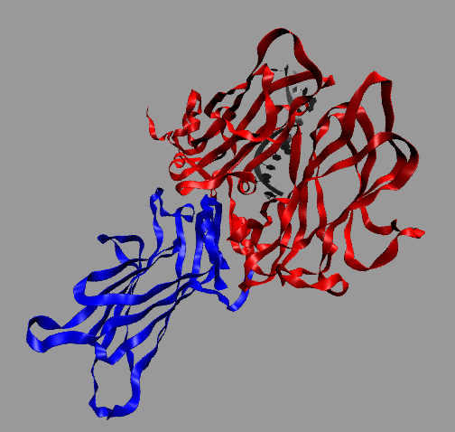
Protein Backbone (1/3)

Slide 5
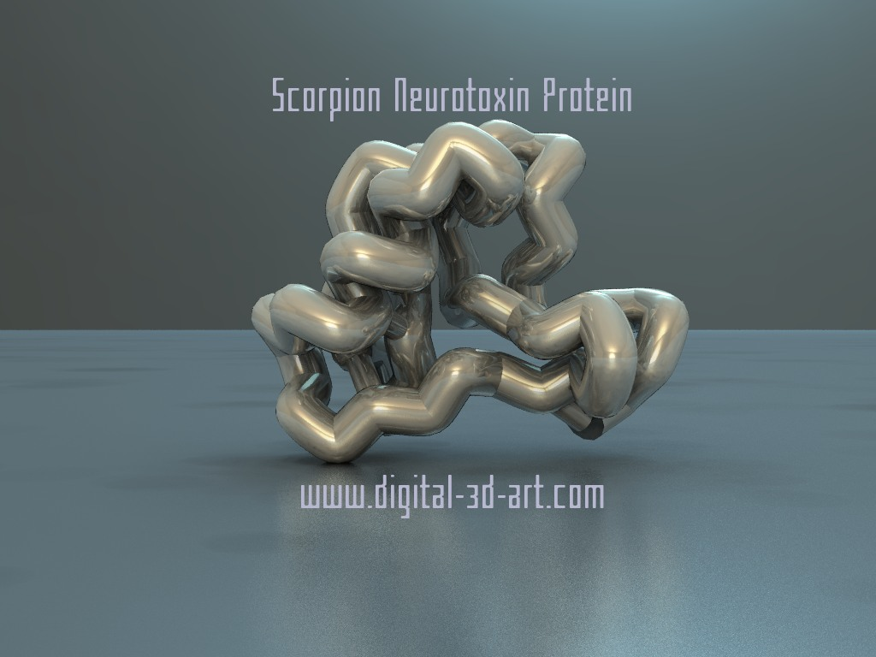
Protein Backbone (2/3)

Slide 6
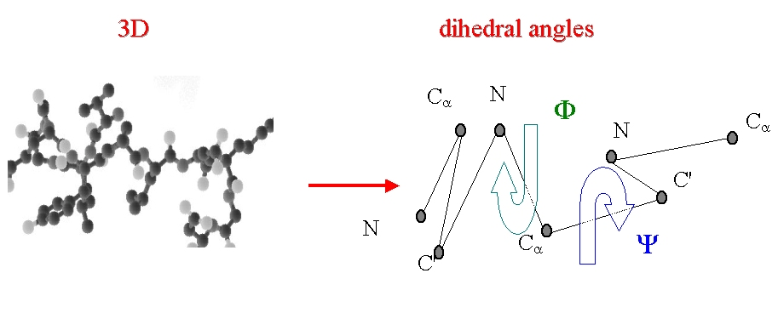
Protein Backbone (3/3)

Slide 7
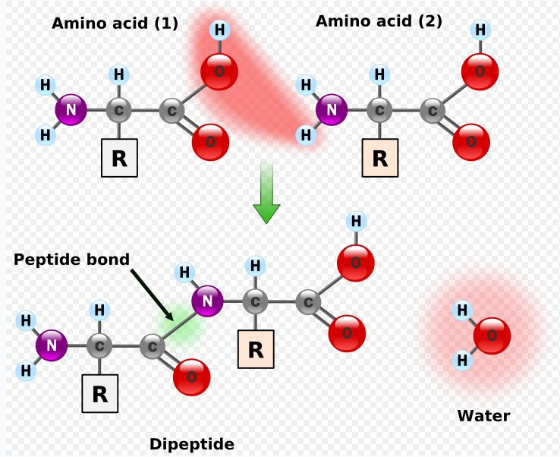
Peptide Bond

Slide 8
Input & Output
Input: the position of C_{α}
Output: the position of N, C’, O

Slide 9
Method
Given set of three consecutive Cα-Cα vectors
The local conformation of the peptide backbone fragment is represented by a combination of three internal distances:
d_{i-1, i+1} ; d_{i, i+2} ; and d_{i-1, i+2}

Slide 10
d_{i-1, i+1} ; d_{i, i+2} ; and d_{i-1, i+2}
i
i+2
i+1
i-1

Slide 11
Chirality
?
=
Notes:
基本介紹一下手性

Slide 12


Chirality (cont’)
Notes:
Paper裡的公式

Slide 13
Distance
The d_{i, i+2} values lie between 4.6 and 7.6
The d_{i, i+3} values lie between 4.2 and 11.0

Slide 14
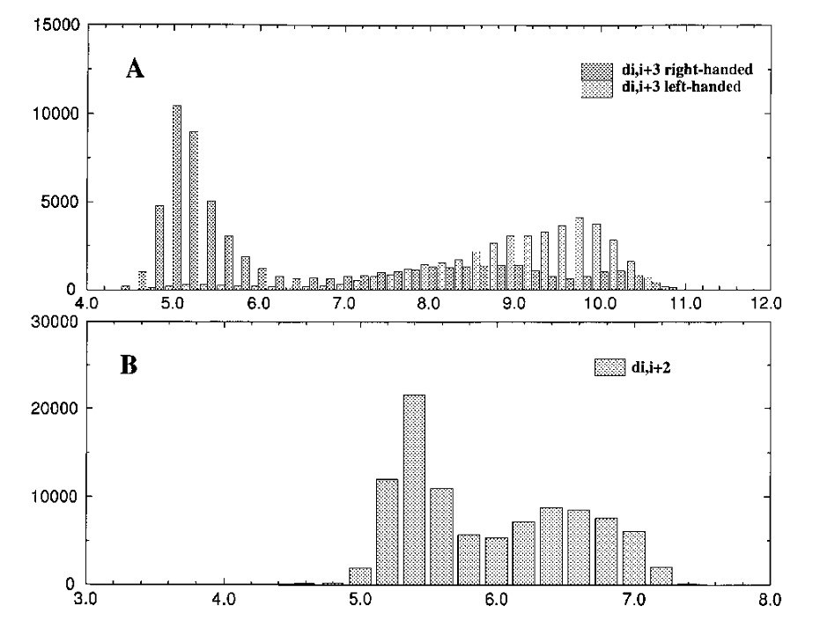

Slide 15
Classes
Used a 0.3 grid in our definition of the local conformation class
10 possible values for d_{i, i+2} and d_{i+1, i+3}
48 values for d_{i, i+3}
Calculated the average positions of C’ , O, N, and C_{β}

Slide 16
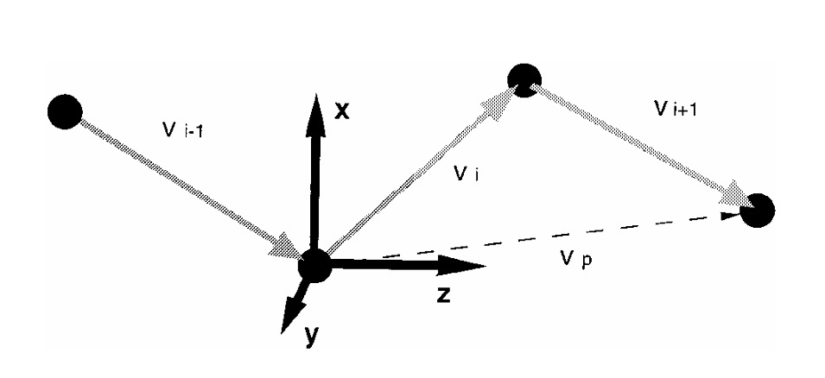
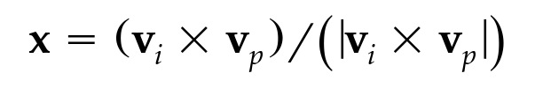


The Local Coordinate System
Notes:
圖 公式

Slide 17
Steps
Calculate the values of d_{i-1, i+1} ; d_{i, i+2} ; and d_{i-1, i+2} and chirality
Find the class of local conformation
For the given local conformation class, find the average C_{α} -> C’, C_{α} -> N, C_{α} -> O, and C_{α} -> C_{β} vectors
Build the local coordination system according to Eqs.
Rotate the vectors and calculate the actual values of atomic coordinate

Slide 18
Dummy Residues
It is possible to calculate predicted coordinates of all backbone atoms for residues from 2 to N-2 of residues
Dummy residues were calculated by repetition of the first and last two vectors

Slide 19
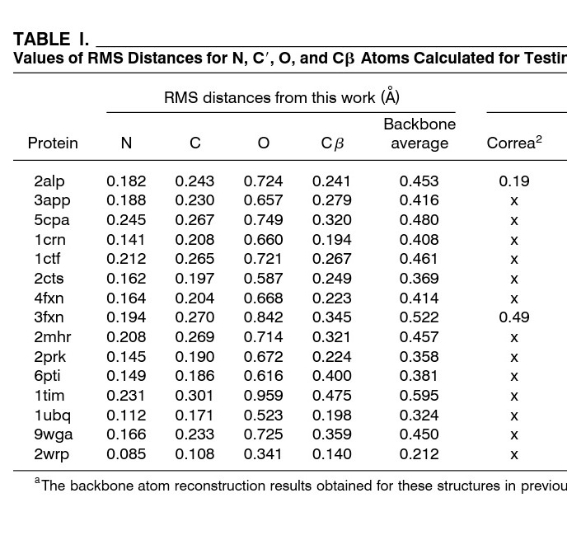
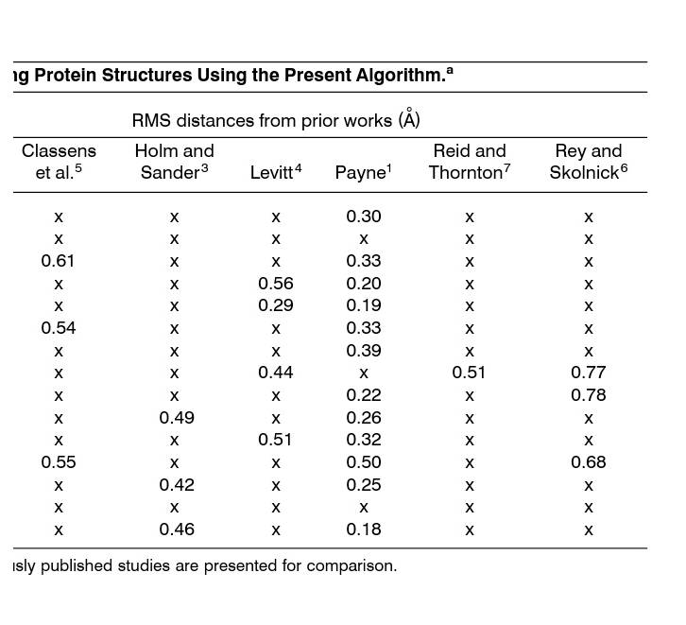
Results(1/4)

Slide 20
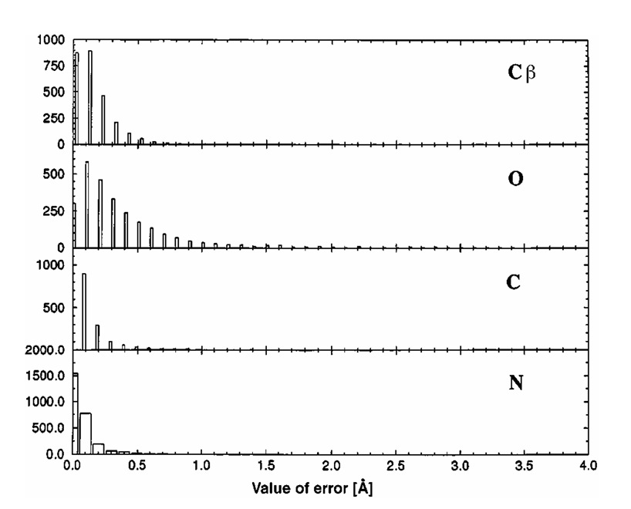
Results(2/4)

Slide 21
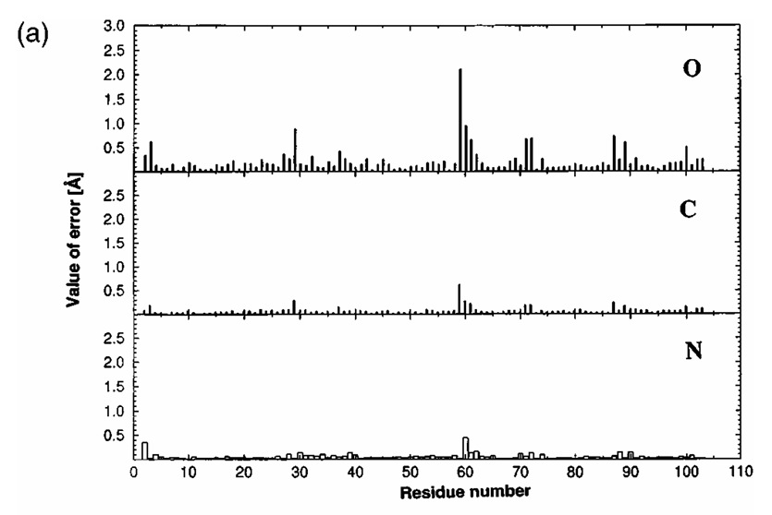
Results(3/4)

Slide 22
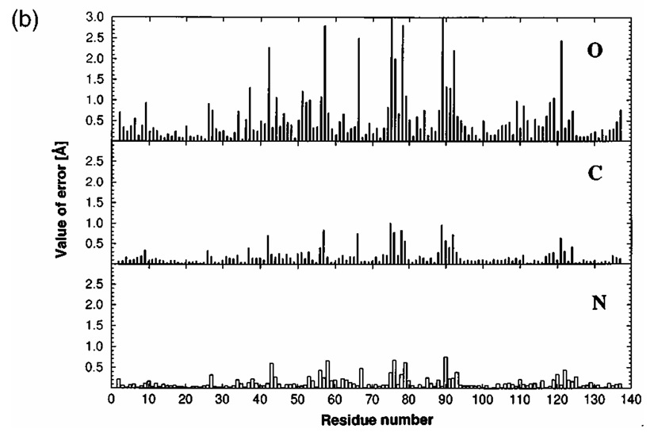
Results(4/4)

